Slide 1
TRACK1_APPLIED_CC_FOR_SOFTWARE_DEVELOPMENT Library management system (RUCE)
Presented By:
1.PRAKASH GARI CHAITHRA -20RU1A0543
2. RAMIREDDY GARI SAI KEERTHANA REDDY -20RU1A0450
3.YARAVA VENKATASUBBA REDDY -20RU1A0560
Guided By:
Hrishikesh Mahure
Edunet foundation

Slide 2

OUTLINE
Abstract
Problem Statement (Should not include solution)
Aims , Objective & Proposed System/Solution
System Design
System Development Approach(Technology Used)
Algorithm & Deployment
Conclusion
References
Future Scope

Slide 3
Abstract
This PowerPoint presentation delves into the world of modern library management, highlighting the transformative impact of digital technology on traditional library systems. The abstract covers key topics such as cataloging, circulation, and user engagement. We explore how libraries have evolved from repositories of physical books to dynamic information hubs, adapting to meet the changing needs of patrons in the digital era. With a focus on automation, data analytics, and user-centric services, this presentation offers insights into the tools and strategies that empower libraries to thrive in today's information-rich environment.Feel free to expand upon this abstract in your presentation as needed.

Slide 4
Problem Statement
“Libraries face a pressing challenge in adapting to the digital age, as traditional cataloging and circulation systems struggle to meet the evolving needs of patrons. With the exponential growth of digital resources and changing user expectations, there is a critical need to address issues such as inefficient information retrieval, underutilization of digital collections, and a potential decline in patron engagement. This problem statement aims to explore these challenges in-depth, identify their underlying causes, and propose innovative solutions to enhance library management in the digital era."

Slide 5
Proposed Solution
Proposed System:
Modernized Library Management System (MLMS)
The Modernized Library Management System (MLMS) is a comprehensive software solution designed to transform the library's operations and user services. It addresses the challenges of inefficiency, inaccuracy, limited accessibility, and resource allocation difficulties encountered in the existing manual system.
1. User-Centric Services
2. Digital Catalog Enhancement
3. Automation and AI
4. Traning and Education
5. Security Measures

Slide 6
System Architecture
The system architecture of a Library Management System (LMS) outlines how different components and modules interact to deliver the desired functionality. Here's a simplified overview of the system architecture for an LMS:
Presentation Layer:
User Interface (UI):This is the front-end interface that library staff and patrons interact with. It includes web-based interfaces, mobile apps, and any other user-facing components.
2. Application Layer:
Web Server: A web server handles user requests from the presentation layer and routes them to the appropriate application components. - *Application Logic:* This layer contains the core functionalities of the LMS, including cataloging, circulation, user account management, and reporting. It processes user requests and communicates with the data layer.
3. Data Layer:
Database: The database stores all library-related data, such as book records, user accounts, circulation history, and catalog information. It is typically a relational database management system (e.g., MySQL, PostgreSQL).
4. Integration Layer:
Third-Party Integrations: Libraries often integrate with external systems for services like online cataloging databases, E-BOOK providers, or authentication services (e.g., LDAP or OAuth) for user logins.

Slide 7
5. Security Layer:
Authentication: This layer ensures that only authorized users have access to the system by verifying their credentials (username and password) or using other authentication methods like single sign-on (SSO).
Authorization: Determines what actions users are allowed to perform within the LMS based on their roles and permissions.
6. Communication Layer:
APIs (Application Programming Interfaces): APIs enable communication between different system components, such as the web server, application logic, and third-party integrations.
7. Data Storage and Management Layer:
Storage: This layer manages the storage and retrieval of data from the database. It includes data caching mechanisms to optimize system performance.
Data Access: Responsible for executing database queries and transactions.
8. Reporting and Analytics:
Reporting Engine: This module generates reports and analytics based on the data stored in the database. It may use reporting tools or custom-built reporting functionalities.

Slide 8
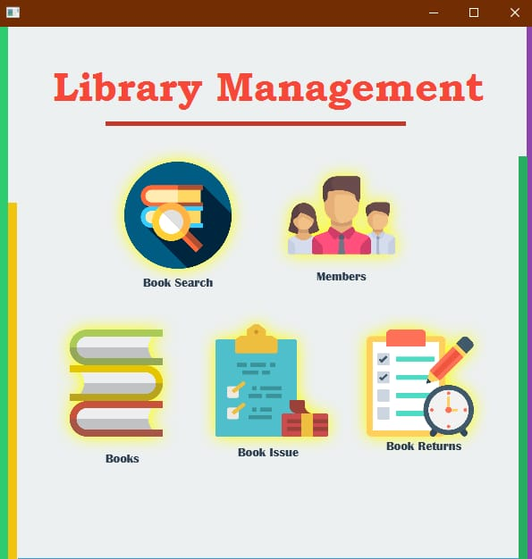
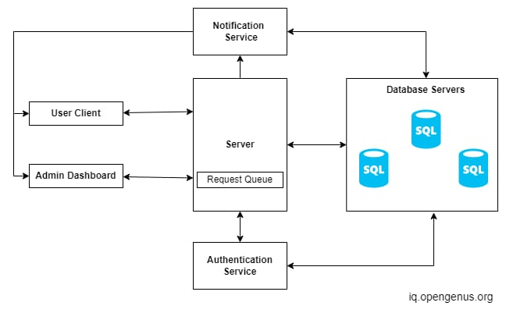

Slide 9



Slide 10
System Deployment Approach
Deploying a Library Management System (LMS) requires careful planning and execution to ensure a smooth transition from the existing system to the new one.
1.Needs Assessment:
Begin by conducting a thorough needs assessment to understand the specific requirements and constraints of the library, including the size of the collection, the number of users, and existing workflows.
2. System Selection:
Choose a suitable LMS software or develop a custom solution based on the library's needs and budget.
3. Pilot Testing:
Before full-scale deployment, conduct a pilot test of the LMS with a small group of library staff. This allows for identifying and addressing any issues or refinements needed in the system.
4. Data Migration:
Transfer existing catalog records, user data, and other relevant information from the old system to the new LMS. Ensure data accuracy and integrity during migration.

Slide 11
5. Customization and Configuration:
Customize and configure the LMS to match the library's specific requirements. This includes setting up cataloging rules, circulation policies, user roles, and other system parameters.
6. Training:
Provide comprehensive training to library staff on how to use the new LMS. This should cover all aspects of the system, from cataloging to circulation to reporting.
7. User Communication:
Inform library patrons about the upcoming changes and the benefits of the new system. Provide guidance on accessing the online catalog, self-service options, and any changes in library services.
8. Parallel Run:
Run the old and new systems in parallel for a period, allowing staff to get accustomed to the new system while ensuring that operations continue smoothly.
9. Data Verification:
Periodically verify data accuracy and system performance during the parallel run. Address any issues promptly.

Slide 12

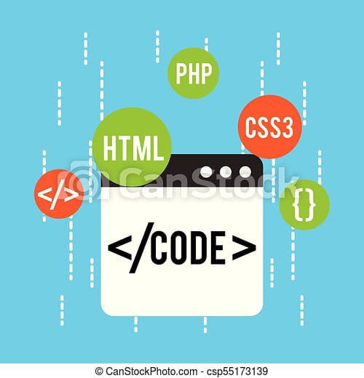

Slide 13
Algorithm & Deployment
Deployment of the Library Management System:
1. Planning:
Define a deployment plan that outlines the timeline, roles and responsibilities, and potential risks.
2. Pilot Deployment:
Deploy the LMS on a small scale to test its functionality and performance in a real-world setting. - Gather feedback from library staff and patrons during this phase.
3. Data Migration:
Perform the final data migration from the old system to the new LMS, ensuring data accuracy
4. Full Deployment:
Roll out the LMS to all library branches or locations. - Configure access permissions and user roles as needed.
5. User Training and Support:
Provide training to all library staff on using the LMS. - Offer ongoing user support to address questions and Issues

Slide 14
6. Monitoring and Maintenance:
Continuously monitor the LMS forperformance, security, and data integrity.
Implement regular maintenance and updates to address software improvements and
security patches.
7. Feedback and Improvements:
Collect feedback from library staff
and patrons regarding their experience with
the new system.
Use feedback to make improvements and enhancements to the LMS.
8. Scalability and Future Planning:
Plan for the scalability of the LMS to accommodate future growth in the library's collection and user base.
Consider future technology trends and advancements.The deployment of an LMS is a complex process that requires careful planning, testing, and ongoing support to ensure its success. By following a systematic algorithm and deploying the system with diligence, libraries can effectively modernize their operations and improve user services.

Slide 15
<!docutype html>
<HTML>
<body>
<h1>THANK YOU..!</h1>
</body>
</html>

